Slide 1
Walk In Our Shoes
By Quang Huynh

Slide 2

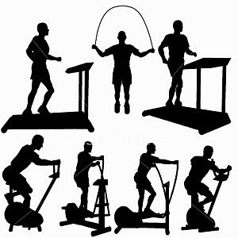
What is Mental Health?
Mental Health is as important as Physical Health. Mental Health involves your thoughts and state of mind. Then, physical health has to do with your body.
Examples:
Physical Health:
Something to keep your physical health positive is to exercise daily.
Mental Health:
One thing to keep your mental health positive is to talk to others.

Slide 3
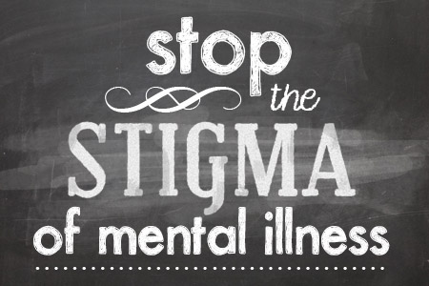
How Stigma Relates to Brad’s Life
Stigma are the names, unfair treatment, and labels to a specific group or person. Stigma comes from incorrect and negative beliefs about a group of people. Stigma relates to Brad’s life because he was constantly thought of the weirdo and was sent to the principle’s office multiple times because the teachers didn’t understand his disability and thought Brad just doing it for attention. This was how stigma had related to Brad’s life.

Slide 4

Mental Health Challenges
1 Thing that I found interesting under the Mental Health challenges is that, you could get an eating disorder if you have a poor mental health relationship. In another I find, called something fishy, people suffering with an eating disorder could experiencing other additive or self-destructive behaviors. Also, in the text it states that I had found that in people who have eating disorders, it is not uncommon to find more associated psychological disorders that coincide within their current eating disorder. Next, I also found out that eating disorders are the main cause of low self-esteem. Also, eating disorders are a negative mean of coping with life and stress. Other negative means of coping with life include alcoholism, substance abuse, self-injury, and self-mutilation. The website that I used is http://www.something-fishy.org/isf/mentalhealth.php

Slide 5
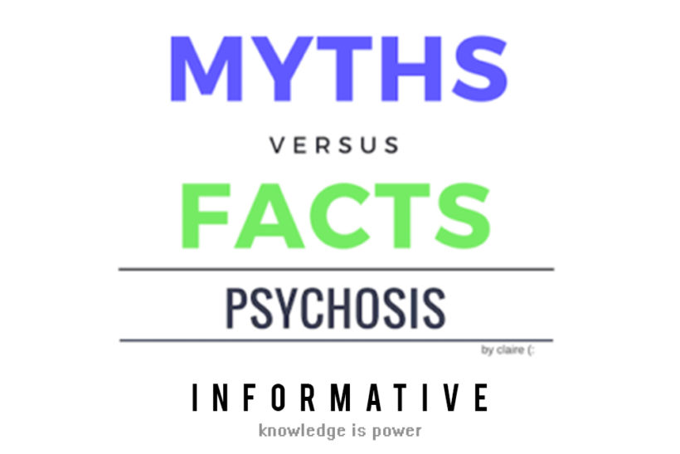
Myth vs Facts
The pair of Myth/Fact that really surprised me the most was that, only adults can get mental disorders only adults can. But the fact is that, even kids can get mental disorders. In fact, anyone at any age could get a mental disorder. This was a myth/fact that surprised me because why would people think only adults can get mental disorders.

Slide 6

Your Shoes

